Slide 1

INFUSION 51A LP
Final Presentation
Simulated equity trading project in fin modeling
Sifan Du, Tong Li, Yibin Zhang, Dennis Pham, Yifu He
2020.04.20

Slide 2
CONTENTS
01
02
03
04
05
Part one
Part two
Part three
Part four
Part five
Portfolio
Construction
Portfolio
Performance
Strategy
Rewind
Further
Improvement
Risk
Analysis

Slide 3


Portfolio
Part One
Construction

Slide 4

Part One
Portfolio Construction
Event-driven Strategy
Event-driven trading strategy is a trading strategy based on the event research method. Event Study is to study whether the stock price will fluctuate when a certain event occurs in the market, and whether it will produce abnormal returns.
1.Step one
2.Step two
Construct an investment theme from the perspectives of macroeconomics, policies, and deterministic events.
Grasp the driving factors such as economic development trends and corporate profitability, then determine the variables with long-term development prospects and strong operability.
3.Step three
4. Step four
Determine the best investment portfolio through the theme industry allocation and individual stocks in the theme industry
Select the appropriate time point by tracking the strength and weakness of the driving factors of the investment theme to carry out the trading operation.

Slide 5
Part One
Stock Selection
Constraints in transaction settings:
Only allowed to adjust positions once a week
Solutions:
Example
Trade in a long-term manner. Only respond to major market events and individual stock events.
3.Comparative Strength
2.Pipline
Example:
Colloidal Gold demonstrated 90.4% sensitivity and 100% specificity in Chinese clinical trial.
Sensitivity (positive): 90.43% (170/182)
Specificity (negative): 100% (182/182)
1.Unmet Need
After the outbreak of the coronavirus in the United States, due to policies such as home isolation, suspension of work and classes, people need to hoard a lot of household goods and food at home, so it is of some help to the retail industry, such as Wal-Mart. So based on this current event, we chose to buy WalMart stock on March 20, and after that Wal-Mart brought us benefits in the next few weeks.
Todos Medical Ltd. has a pipeline of diagnostic assets to test Andis SARS-CoV-2, the coronavirus that causes COVID-19. It can produce colloidal Gold test in large quantities.
Since mid-January, more than 84000 specimens from US patients have been tested for Covid-19. Labs around the country are reporting shortages of some of the chemicals and other materials necessary to perform diagnostic tests.

Slide 6



Portfolio
Part Two
Performance
Analysis

Slide 7
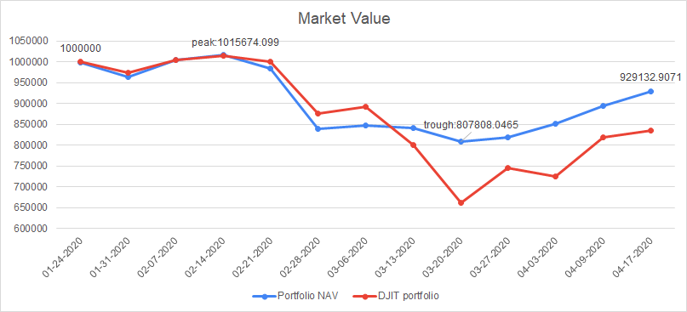
Part Two
Portfolio Performance
Overall Evaluation
1. The average return:-0.5960%.
2. Outperform the DJIA index by 0.8943%
3. Win 7 times and lose 5 times.
4. Maximum drawdown is 20.47%

Slide 8
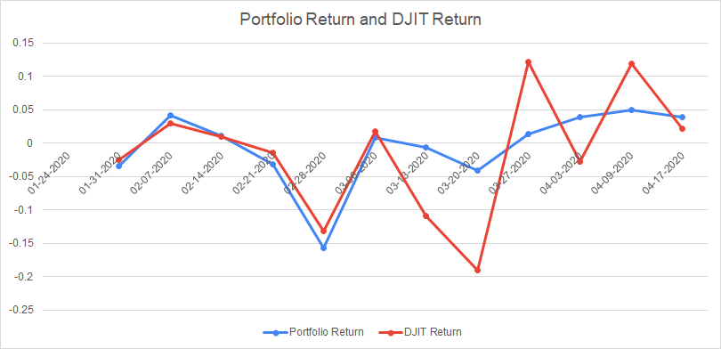
Part Two
Portfolio Performance
Portfolio Return compare to benchmark
Since the trade is once a week, it is impossible to stop-loss after the sell signal. After the outbreak of cov19, we changed our strategy by closing much of the tech company, then long the less risky stock in the Retailing and telecommunication industry, like WMT and VZ. The latter spent 400 million buying video conferencing platform bluejeans.

Slide 9
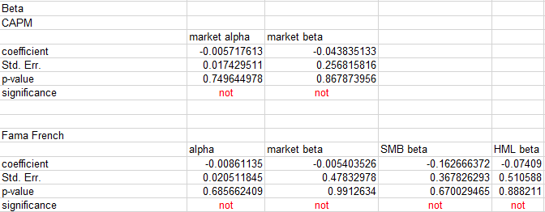
Part Two
Portfolio Performance
Calculation of factors in CAPM and 3-factor model
Unsurprisingly, all the coefficients of the CAPM model and Fama-French model are insignificant, they both fail to explain what happened on the market.

Slide 10
Strategy
Part Three
Rewind
Analysis

Slide 11
Part Three
Where we make profits
Strategy Rewind
Boeing Co - BA
We found that despite Boeing’s own serious problems, its share price did not decrease significantly during those days. At the same time, we found that Boeing has adjusted its executives to fix their problems, and it is reasonable to believe that its stock price will rebound when it has already fallen at that time. If Boeing can handle its problems well, there may be a continuing upward momentum later. For these reasons, we allocated 30% for Boeing at the beginning. The facts show that Boeing’s rose steadily in the first three weeks from 323 to 340, a 5% increase.
Verizon Communications Inc. - VZ
Because the stay-at-home orders are spread throughout the United States, network operators provide a lot of support in all aspects of life, study and work for people. As the largest operator in the United States, Verizon has reason to believe that it will play a huge role during the virus pandemic. After the U.S. stock market stopped falling wildly, we reopened our position to go long on Verizon. In a four-week period, Verizon showed steady growth, from 51.8 to 58.46, close to a 13% increase.

Slide 12
Part Three
Where we lose
Strategy Rewind
Sold all the stocks within the two weeks
in the face of this unprecedented event, we cannot judge when the market has successfully bottom out. Facts show that after the market continued to fall crazily, there was also a short crazy rebound. We believe that blindly chasing short positions or open long positions may cause us to lose more. Therefore, we sold almost all the stocks within the two weeks of the overall decline in US stocks, which caused our previous earnings to turn into bubbles.
Apple Inc. - AAPL
From previous experience, technology stocks still perform relatively well in the economic downturn. Apple has always released new products or systems in the spring in the past few years. We believe that these events will prevent Apple from falling wildly. Obviously this time is an unusual time. However, after Apple introduced the new MacBook Air and IPhone SE2 in recent times, as the market stopping falling as well, the Apple stock price continued to rise from 229.24 to 282.8, a 23% increase.

Slide 13


Part Four
Further Improvement
How can we improve our strategies

Slide 14


Part Four
Further Consideration
Showcase of Loss we should have avoided
2/28/2000 - The pandemic was spreading and affecting countries all over the world. With the pandemic rising to huge news alert and two halting periods in US exchanges we continue to hold a long position. What should have been done was to take the news more seriously and shifted to an aggressive short position with any stock focusing specifically on consumer retail.

Slide 15
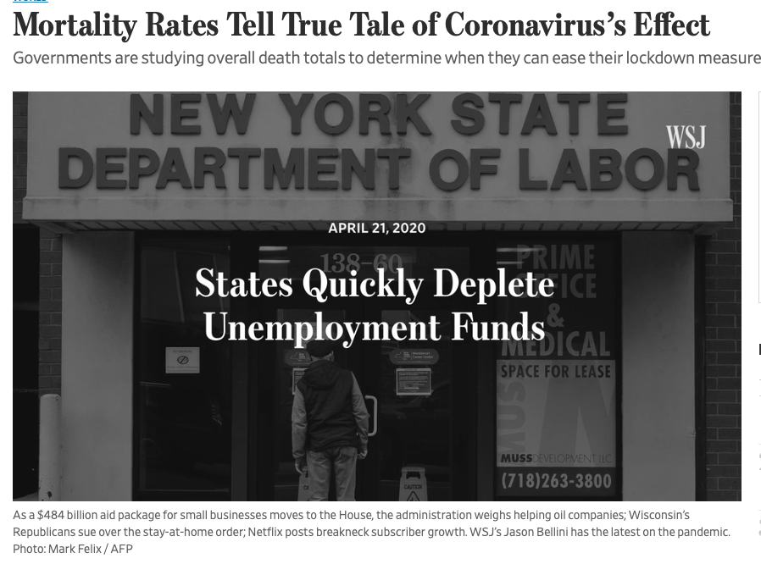
Part Four
Further Consideration
Potential Profit Opportunities we missed
04-03-2020 and 04-09-2020
These two weeks were special in that the pandemic had its so called first decreasing death rate for daily data. Then also, the stimulus package from the government was holding an optimistic view on the economy. With the huge positive news and potentially end to the statewide quarantines the economy’s project was positive. Here we should have allocated our portfolio in companies that had the largest lost the few weeks priors for large short-term returns.

Slide 16

RISK
ANALYSIS
Part Five
How to leverage risk
under extreme
market situation

Slide 17
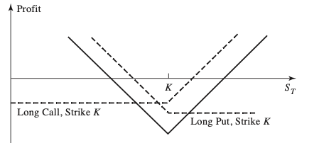
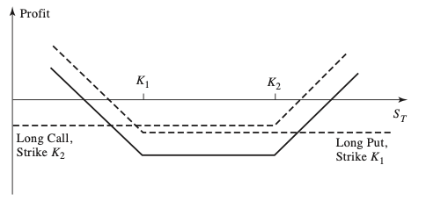
Part five
Risk Analysis
How to minimize risk under extreme market situation, like Coronavirus crisis
1. Non-Directional Investing
Straddle
Strangle

Slide 18
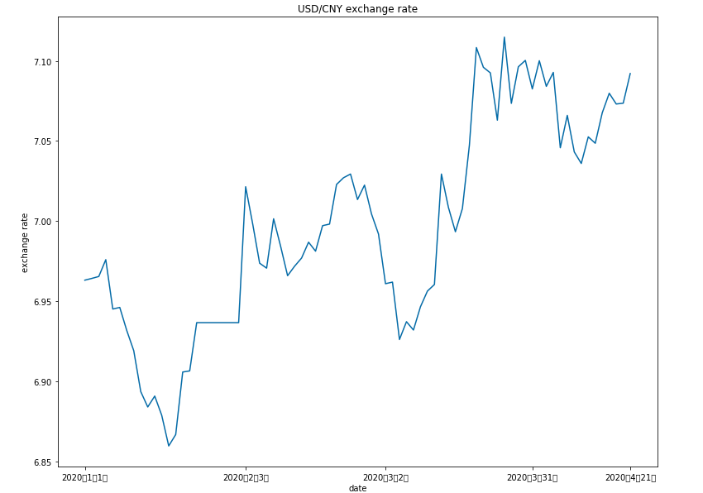
Part five
Risk Analysis
How to minimize risk under extreme market situation, like Coronavirus crisis
2. Equity – Market Neutral Strategy
The goal is to leverage differences in stock prices by being both long and short among stocks in the same sector, industry, nation, market cap, etc.
3. Speculate opportunity on exchange market
Why USD goes up in short-term?
Why should we short USD?

